Slide 1
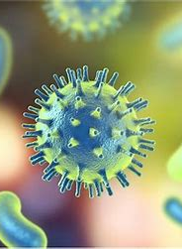
Allergies
GTHBY Human Biology

Slide 2
Learning Intentions
Increase in allergy disorders, especially in children
Possible causes of the increase

Slide 3
Success criteria
Relate allergies to the immune system and inflammatory response
Identify the causes of allergies
Classify allergic responses as intolerances, allergic reaction and anaphylaxis
Explain why allergies are increasing in frequency, especially amongst children

Slide 4
Review:
Explain the difference between phagocytes and lymphocytes.
What is an antigen?
What is an antibody and where are they produced?
List 5 inflammatory responses

Slide 5


Slide 6
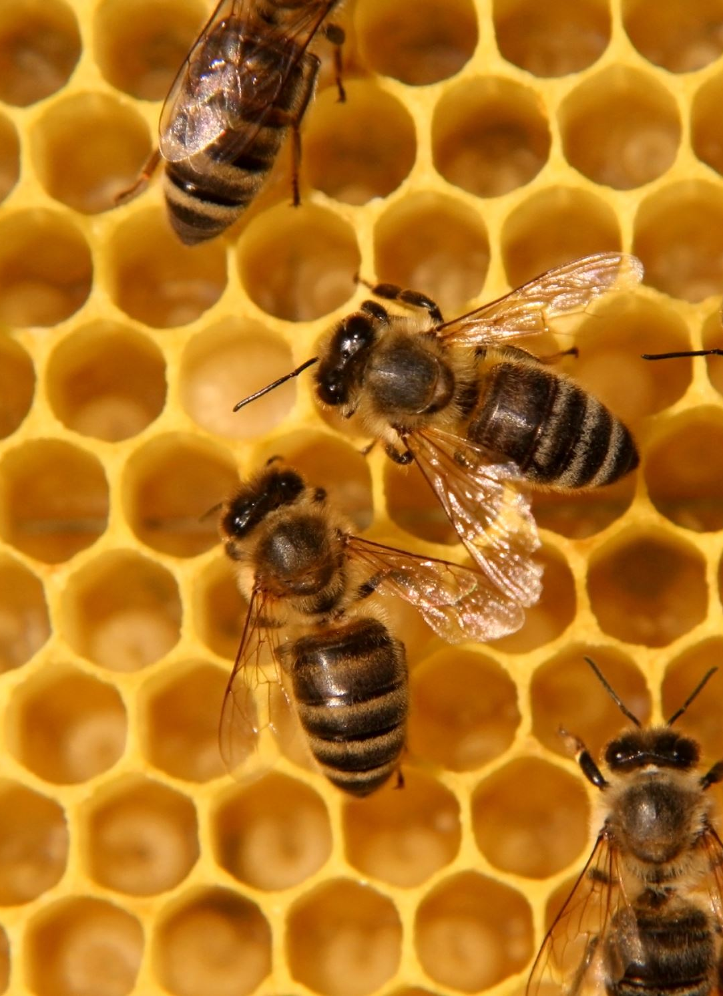
What are allergies?
Allergies occur when your immune system reacts to a foreign substance — such as pollen, bee venom or pet dander — or a food that doesn't cause a reaction in most people.

Slide 7


Slide 8
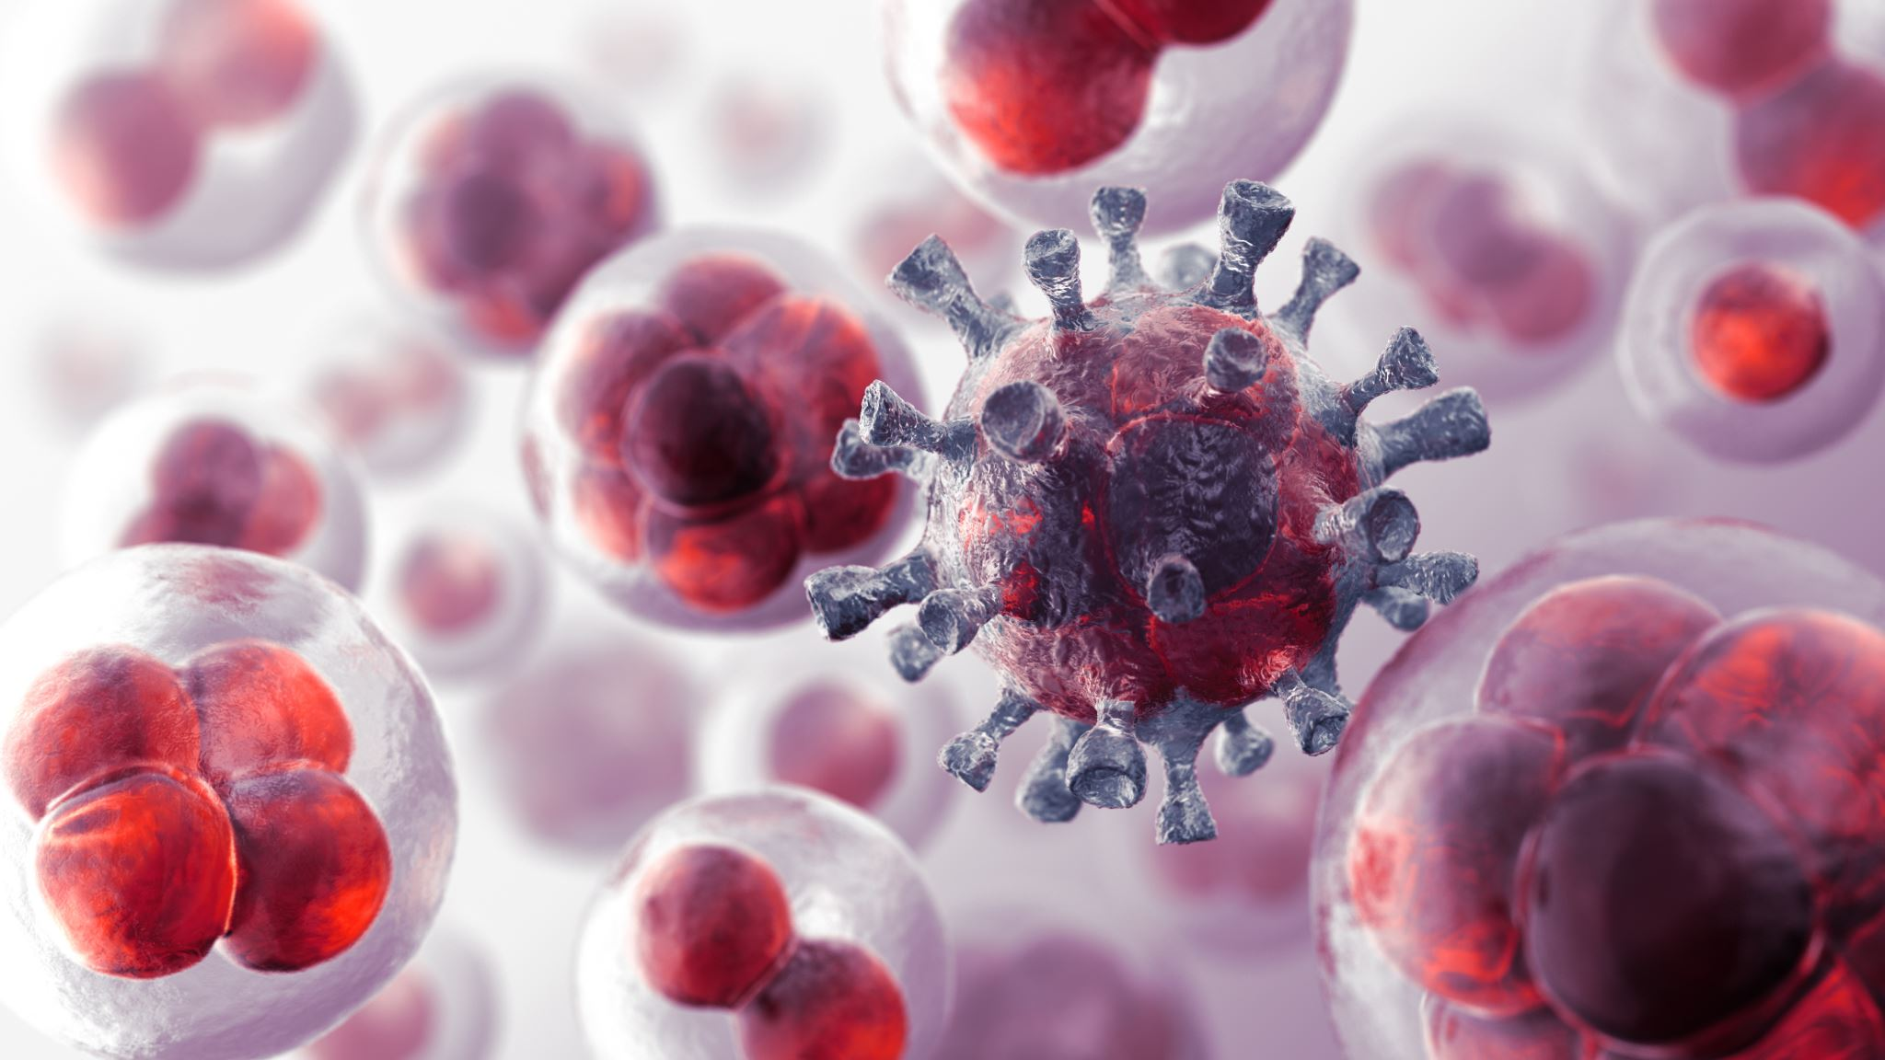
How do we develop allergies?
Your immune system produces substances known as antibodies. When you have allergies, your immune system makes antibodies that identify a particular allergen as harmful, even though it isn't. When you come into contact with the allergen, your immune system's reaction can inflame your skin, sinuses, airways or digestive system.

Slide 9
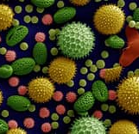
Severity of allergies
The severity of allergies varies from person to person and can range from minor irritation to anaphylaxis — a potentially life-threatening emergency. While most allergies can't be cured, treatments can help relieve your allergy symptoms.

Slide 10


Slide 11


Slide 12
Why are allergies becoming more common? 1. Delayed introduction of food allergens
Parents are avoiding introducing their children to potentially allergenic foods meaning that children react abnormally to the allergens once they do encounter them.

Slide 13
2. The hygiene hypothesis
A lack of exposure to microorganisms during early childhood affects the gut microbiome and causes the immune system to identify food proteins as infectious agents mistakenly. Parasitic infections are usually combatted by the same immune mechanisms that are used to tackle allergy.

Slide 14
3. Vitamin D hypothesis
Researchers have started to notice that food allergy prevalence seems to coincide with the availability of sunlight.
The idea is that vitamin D can help regulate the immune system so that the body is less susceptible to allergy.

Slide 15
Success criteria
Relate allergies to the immune system and inflammatory response
Identify the causes of allergies
Classify allergic responses as intolerances, allergic reaction and anaphylaxis
Explain why allergies are increasing in frequency, especially amongst children

